Slide 1
Group 9
CubeSat
Introduction to Space Communications

Slide 2
Zee
CubeSat limitation:
  LEO connection window is short.
  CubeSat Unit is very small.
  Current software protocol (AX.25) limits CubeSat (9.6 kb/s)
  Increasing number of CubeSats saturates the band
Other issues
  Fading signal
  Interference
  Sat orientation
  Synchronization

Slide 3
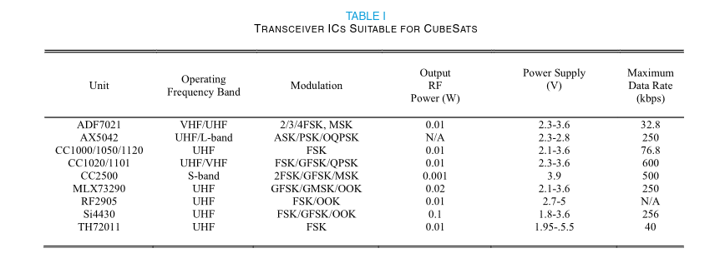
Zee

Slide 4
Zee
Sat needs to be high data rate
Sat needs to be reconfigurable in flight.
Solutions?
  Commercial software packages eg. Cadet at 24Mb/s
  Custom software packages
    Integrated Transceiver ~250 kb/s
    RF integrated circuit or SoC (highly reconfigurable)

Slide 5
Zee
Additional information: https://ieeexplore.ieee.org/stamp/stamp.jsp?tp=&arnumber=9229089
Where to go from here?
  Radio design. Referenced includes the radio design for mentioned communication strategies.
  Choosing a software implementation. Best done early to help with planning.

Slide 6
David

Slide 8
Morgan

Slide 10
Jon

Slide 12
Carson

